Slide 1
ALPHAMEKS
HYDRAULIC SERVICES

Slide 2
ALPHAMEKS
Repairments & Construction of Hydraulic Systems
( high/medium/low pressure )
Supplier of spare parts for Hydraulic Systems
Inspections & Services Worldwide
Certified by Bureau Veritas
ISO 9001:2015

Slide 3
The founder of our company with many years of experience, has created a team of highly skilled and specialized personnel, consisting of Mechanical Engineers NTUA and experienced technicians that offer our services worldwide
Our services can be applied to :
Marine cranes (low/medium/high pressure) as IHI, TSUJI, FUKUSHIMA, MITSUBISHI, HAGGLUNDS, TTS, NORWINCH, BRATTVAAG, O&K, LIEBHERR, NMF etc.
All types of anchors & deck winches
Hydraulic steering, hydraulic opening - closing hatch cover systems
Hydraulic Unloading tankers (cargo control & ballast valves , framo systems, etc.)

Slide 4
Our target is and remains the continuous support of our customers wherever they are in the world, with honesty, consistency and responsibility, guided by the international standards
We supply our customers with the most suitable spare parts of trusted brands such as BOSCH REXROTH, HYDROMATIK, UCHIDA, PARKER, DENISON, VICKERS, EATON, STAFFA, KAWASAKI, IHI, MITSUBISHI etc.
Repairments of all hydraulic components ( pumps, motors, valves, fittings, tubing, mouthpiece etc.)
Design & manufacture of all kinds of hydraulic assemblies – hydraulic cylinders & valve blocks

Slide 15
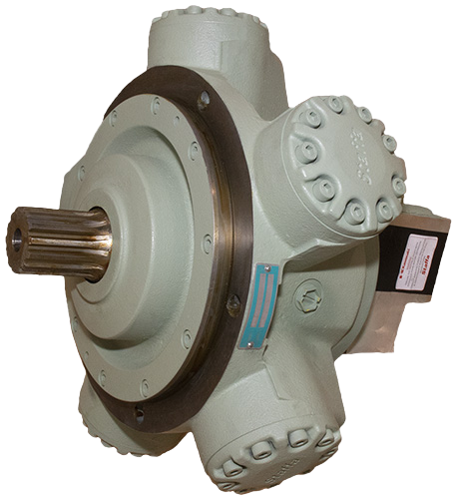

Slide 24
ALPHAMEKS
HYDRAULIC SERVICES

